Slide 1

Department of Information Technology
A.P. Shah Institute of Technology
G.B.Road,Kasarvadavli, Thane(W), Mumbai-400615
UNIVERSITY OF MUMBAI
Academic Year 2019-2020

Slide 2
A Project Report on
SINGLE SIGN ON
Submitted in partial fulfillment of the degree of
Bachelor of Engineering(Sem-7)
in
INFORMATION TECHNOLOGY
By
Nirmit Dagli(16104013)
Sarvesh Sawant(17204013)
Mihir Deorukhkar(16104065)
Under the Guidance of
Prof. Kaushiki Upadhayaya Prof.Nahid Shaikh

Slide 3
1.Project Conception and Initiation

Slide 4
1.1 Abstract
Consider a college education portal needs to provide diﬀerent courses and tutorials to its students. But to incorporate numerous resources and tutorials onto one education portal can be tedious and space constraint.
Having multiple systems typically require multiple sign-on dialogues to access the resources. Users need to register on multiple portals to access the contents and courses and it involves the headache of remembering multiple sets of credentials.
Users also have to present credentials multiple times they login to these portals/websites. With these scenarios, more the portals, the more sign-ins are required. It also requires to restrict access to unauthorized users when log-ins are authenticated.
If there are redundancy of resources and inconsistent information across multiple website across the systems, users may show lack of interest. Single sign on system is the proposed method to provide access to the educational learning resources/contents.
In this approach only one set of credential is required, user can access the multiple services with those same credentials once integrated into all systems. This approach provides a secure way to authenticate users and give access to all services.

Slide 5
1.2 Objectives
To provide a service for accessing multiple platform using single credential
By using LDAP , a single central database will maintain information of multiple accounts at the same time.
Making Authorization process more Secure.
Reducing the database chunk with one central database.

Slide 6
1.3 Literature Review
Sr. No | Title/Author | Method used
1. | Pranav B. Sahare, Design and implementation of single sign-on system for educational systems. | Implementing SSO using API.
2. | Anjali Nair,Arun Madhu & Jubilant J “Security Issues of Single Sign on Web Services”,2015 | Identification of flaws and risks associated with SSO service
3. | Jian Hu,Qizhi Sun & Hongping Chen, “Application of Single Sign On In Digital Campus”,2010 | Implementinng SSO using LDAP protocol

Slide 7
1.4 Problem Definition
In our college we have multiple services like Moodle, Payment Portal, HandBook, Webstore, IT Server, Internet Password,etc. To access them students need to remember various ID’s and Password. To maintain this services different databases are used.
To solve this problem we can use LDAP, in which student/staff will require just a single password to access multiple services.

Slide 8
1.5 Scope
Since a single user may require multiple credentials to login, our system provides a SSO service that reduces the burden of remembering multiple id and password.It eliminates the job of getting authorized on each website we enter.
Every organization has multiple services which has their own different id’s and passwords which brings inconvenience to the user, so single sign-on is a solution to this problem.

Slide 9
1.6 Technology stack
LDAP
PHP
College Software:- MOODLE

Slide 10
1.7 Benefits for environment & Society
By increasing the users of the distributed systems that should often access to remote resource, diﬀerent authentication techniques are needed when users want to enter the systems. Therefore, SSO technology has been introduced as a special form of authentication mechanisms.
This technology is meant to facilitate the job for users in a way that with one credentials they could be able to access to several software resources on diﬀerent servers.

Slide 11
2. Project Design

Slide 12
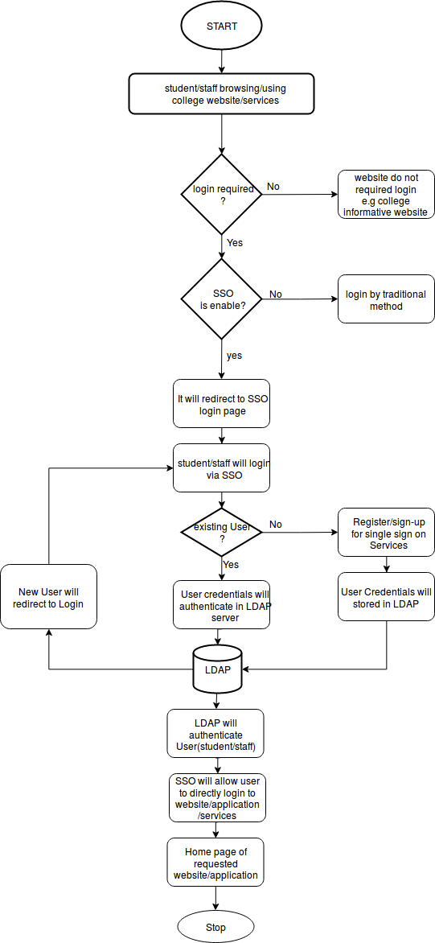
2.1 Proposed System

Slide 13
2.2 Design(Flow Of Modules)
User needs to register.
User will be redirected to login page.
User details will be stored in LDAP Server.
Admin can also create user and maintain the user.
Once the user will login to Single Sign On portal, the user will be able to access the websites which are integrated with the LDAP Server.

Slide 14
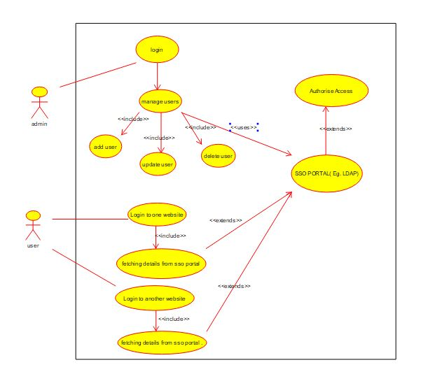
2.3 Description Of Use Case
Our use case consists of two major entities that interact with the major modules of the system.
The first one is the user who can sign up/login, login to multiple Website.
The second is the administrator who has an access to access the backend database enter and manage records, handle authentication process. Also maintain various CRUD operation.

Slide 15
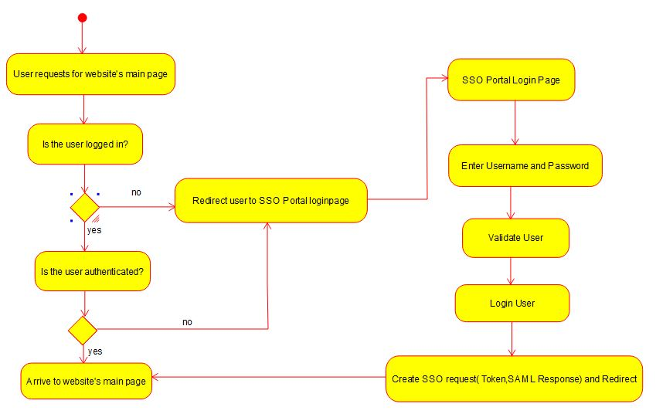
2.4 Activity diagram
Activity diagram begins with users request for a webpage.
If the user is logged in then the user will be authenticated. If the user is not logged in the user will be redirected to the SSO login Portal.
The user need to enter the SSO credentials. Then the user will be validated and a token will be generated .This token will be sent to the request website and the user will be able to access the requested website.

Slide 16
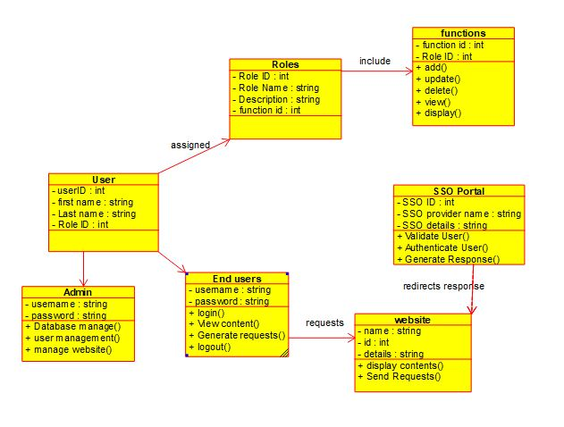
2.5 Class Diagram
The class diagram alongside displays various modules of our system interacting with each other.
System is divided into two users admin and end user.
All users are classified into different roles and each role is associated with different function.
End user requests for the website and this request is sent to the SSO portal. The SSO portal validates the user and redirect the response to the website.

Slide 17
2.6 Module-1
Login/Register
New user need to register to Single Sign On Portal.
Existing users just need to login to access the websites associated with LDAP.
Once the user successfully login to the Single sign on webpage the user will be able login to any of the websites without re-entering the username and password.

Slide 18
Module-2
Authentication
When the user tries to login to the LDAP server, the LDAP server will authenticate the user.
All the user’s credentials will be saved in the LDAP server.
If a new user is created his entry will be stored in LDAP server.

Slide 19
Module-3
Single Sign On Interface
Once the user is authenticated he will be redirected to website as per the requirement of the user.
User will be able to use any college website once Logged by same user credentials.
Single Sign On interface will maintain the session for User.
Single Sign On interface will also have Facility to change the password.

Slide 20
2.7 References
APPLICATION OF SINGLE SIGN-ON (SSO) IN DIGITAL CAMPUS Jian Hu,Qizhi Sun, Hongping Chen
An Automated Enterprise IT Management System Based on LDAP
OAuth-SSO: AFramework to Secure the OAuthbased SSO Servicefor Packaged Web Applications
Moodle Server, https://cloudcone.com/docs/article/how-to-install-moodle-on-ubuntu-1804/,
LDAP Server, https://computingforgeeks.com/install-and-conﬁgure-openldapphpldapadmin-on-ubuntu-18-04-lts/,

Slide 21
3.Planning for next semester

Slide 22
Planning
Authentication of users.
Configuring college websites using LDAP.
Integrating Login Page with LDAP server.
Maintaining a central Database.
Single Sign out(Security Purpose).

Slide 23
Thank You

